Slide 1

McDonald’s Nutrition
Name: B. Manohar
Reg No: 12100789
Roll No: RK21UW51
Section: K21UW

Slide 2
Table of Contents:
Name
Introduction
Project Overview
Steps of EDA
Null Values
Univariate Analysis
Bivariate Analysis
Multivariate Analysis
T-test
ANOVA(F-test)
Chi-Square test
Conclusion

Slide 3
INTRODUCTION:
McDonald's is one of the largest and most popular fast-food chains in the world. It is known for its convenient and affordable meals, but there have been concerns about the nutritional quality of its food.
This report presents the results of an exploratory data analysis (EDA) of McDonald's nutrition data. The data was collected from the and includes information on the calories, fat, sugar, and other nutrients in each menu item.
The goals of this EDA were to:
Understand the nutritional content of McDonald's food.
Identify any relationships between the different nutrients.
Make recommendations for how people can make healthier choices when eating at McDonald’s.

Slide 4
Project Overview:
This project is an exploratory data analysis (EDA) of the McDonald's nutrition dataset. The goal of this project is to identify trends and patterns in the nutritional content of McDonald's food, identify healthier menu options, and make recommendations to McDonald's on how to improve the nutritional content of its food.
Data
The data used in this project is the McDonald's nutrition dataset. This dataset contains information on over 300+ menu items from around the world. The variables in the dataset include:
Item
Calories
Calories from Fat
Total Fat
Saturated Fat
Trans Fat
Cholesterol
Sodium
Carbohydrates
Fiber
Sugars
Proteins
Weight

Slide 5
Steps of EDA:
Exploratory Data Analysis (EDA) is a crucial step in the data analysis process that helps you understand your dataset, identify patterns, and prepare the data for further analysis or modelling. Here are the steps typically involved in EDA:
Data Collection: Gather your dataset from reliable sources. Ensure that you have all the necessary data to perform your analysis.
Data Loading: Load the dataset into your analysis environment. Common tools for this step include Pandas in Python or read functions in R
Initial Data Inspection: Use Pandas to check the first few rows of the dataset with df.head() to get an overview of the data's structure. Use df.shape to determine the number of rows and columns in the dataset. Use df.info() to get information about the data types of each column and check for missing values.
Data Cleaning and Handling Missing Values: Identify missing values using functions like df.isnull().sum(). Decide on a strategy for handling missing values (e.g., imputation or removal) based on the nature of the data and the analysis goals. Use Pandas functions to perform data cleaning, such as dropping unnecessary columns or duplicates.
Data Visualization: Create visualizations like scatter plots, box plots, and violin plots to explore relationships between variables. Visualize trends and patterns in the data. Use Seaborn pair plots or heatmaps for a comprehensive view of variable relationships.
Outlier Detection: Identify potential outliers by visualizing data using box plots or other relevant techniques. Decide on an approach for handling outliers, which may include removal or transformation.

Slide 6
Feature Engineering: Create new features, if necessary, based on domain knowledge or relationships observed during EDA. Perform feature transformations, such as scaling or normalization, if it improves the quality of the data.
Hypothesis Testing (Optional): If relevant, conduct statistical tests or hypothesis tests to make data-driven conclusions about specific relationship or hypotheses.
Documentation and Reporting: Document your findings, insights, and any actions taken during EDA. Create visualizations and reports that communicate your results effectively.
Iterate: EDA is an iterative process. You may need to revisit previous steps as you gain more insights or encounter issues during the analysis.

Slide 7
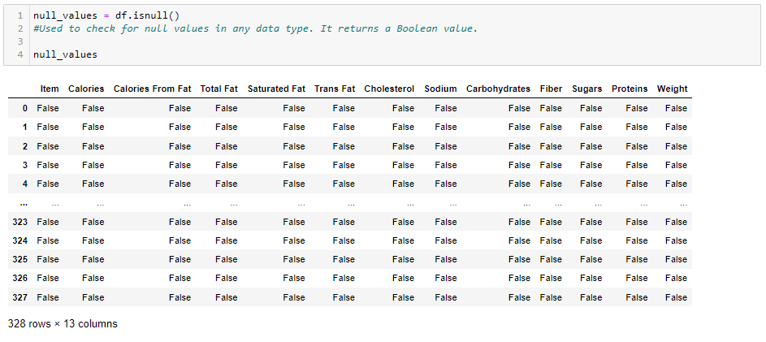
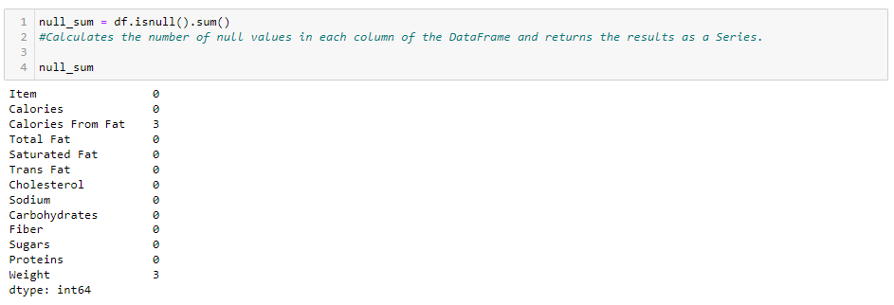
Null Value
Sum of Null Values:

Slide 8
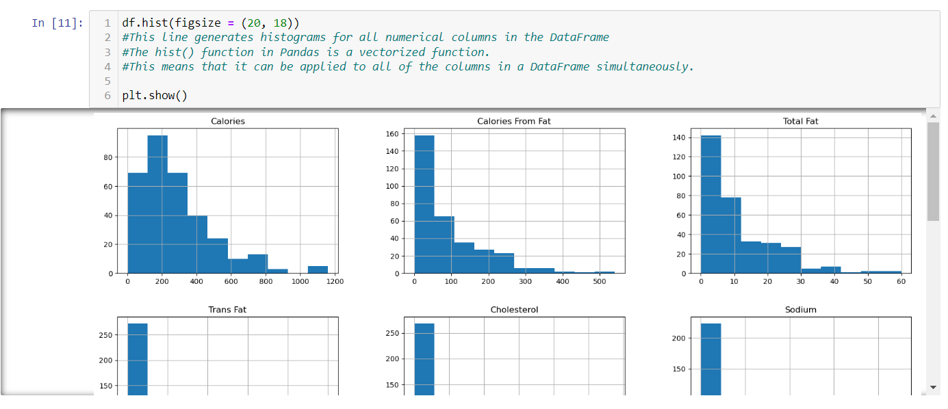
Univariate Analysis: Univariate analysis is a basic type of statistical data analysis that uses only one variable.
It involves generating summary statistics, visualizations (e.g., histograms, box plots)

Slide 9
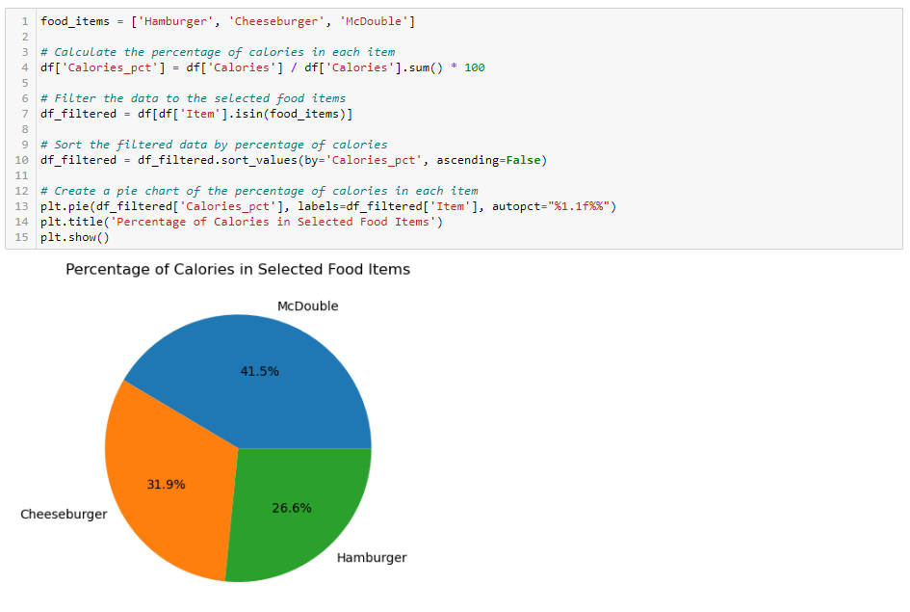
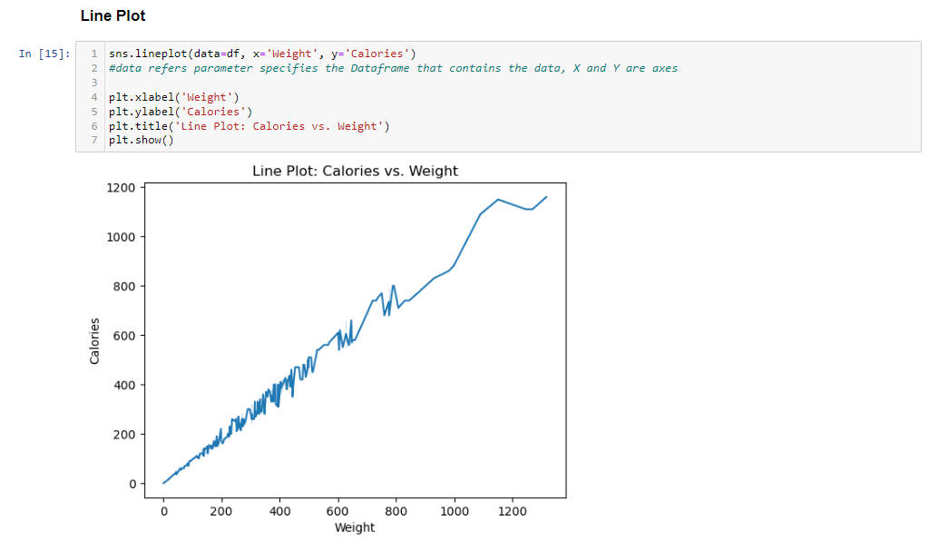
Pie Chart:
Line Plot:

Slide 10
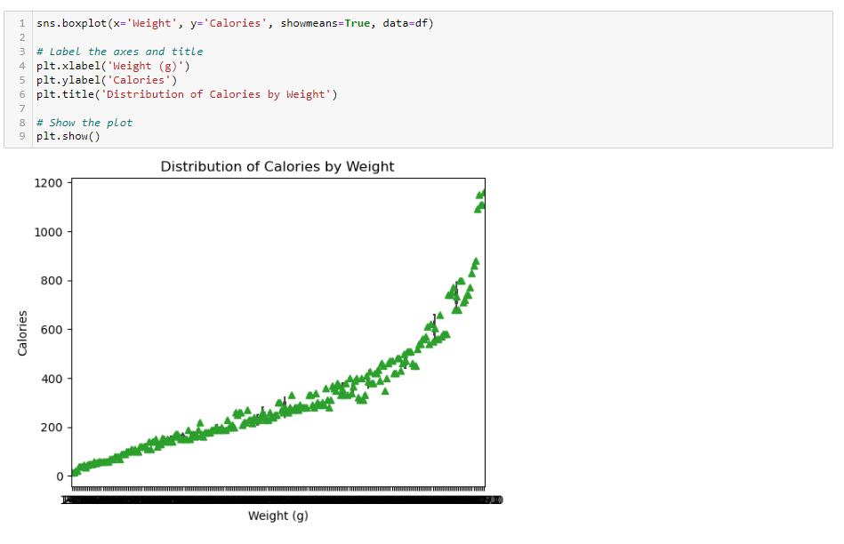
Bivariate Analysis: Relationship between two variables. Bivariate analysis
Can be visualized using a scatterplot, bivariate table, or box plot

Slide 11
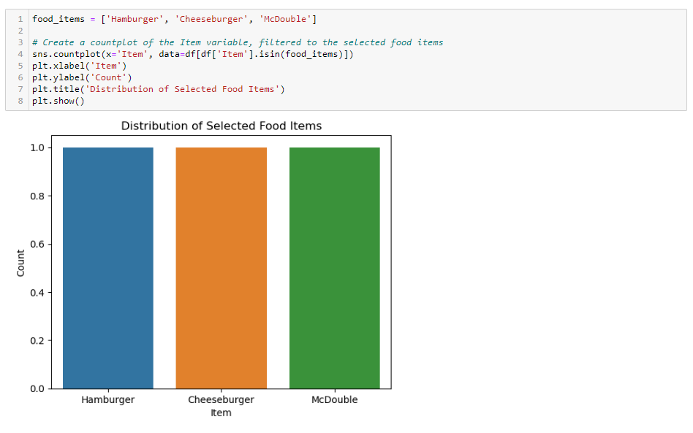
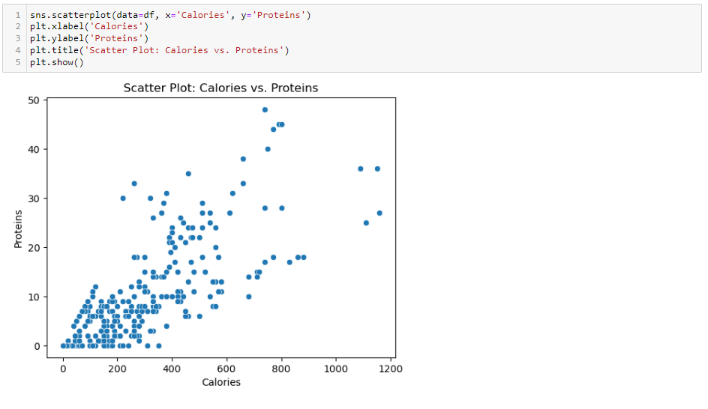
Count Plot:
Scatter Plot:

Slide 12
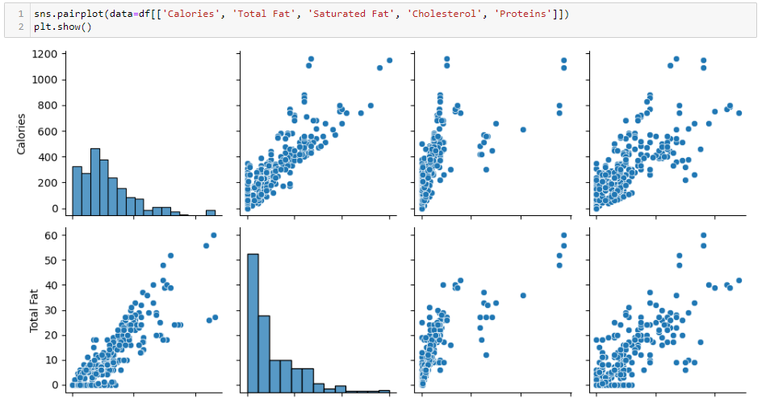
Multivariate Analysis: Involves evaluating multiple variables (more than two) to identify any possible association among them

Slide 13
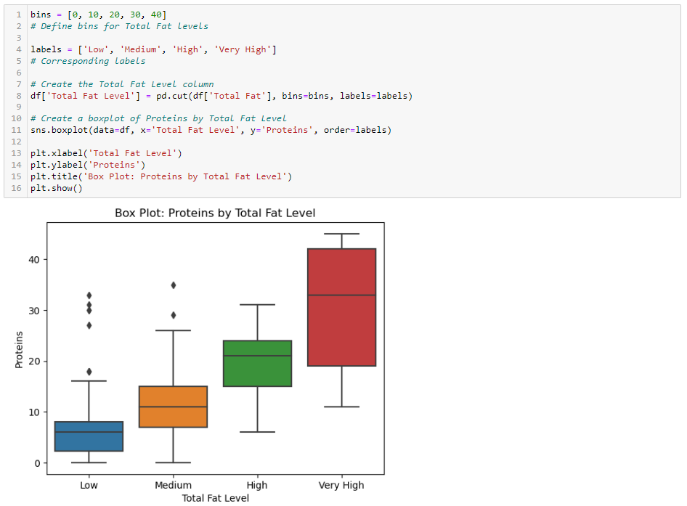
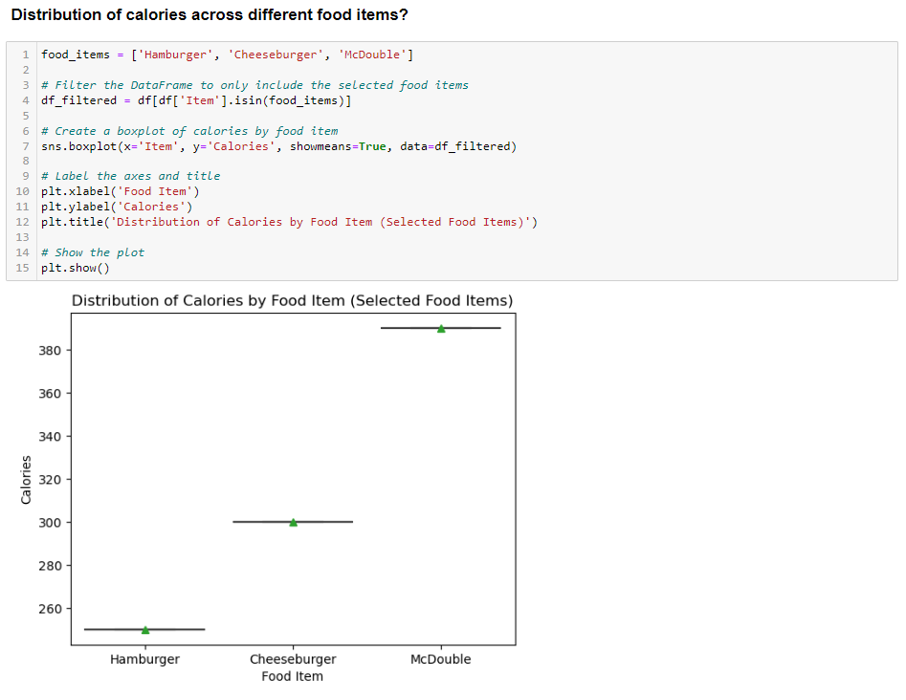

Slide 14
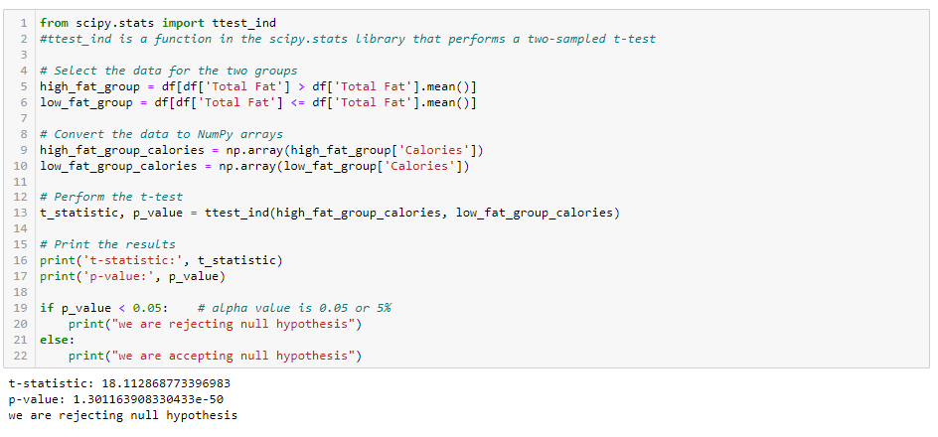
T Test:
A t-test is a type of inferential statistic which is used to determine if there is a significant difference between the means of two groups which may be related in certain features

Slide 15
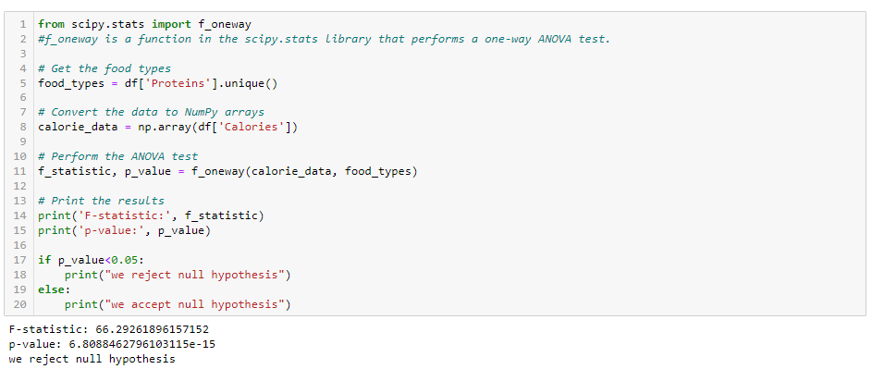
ANOVA Test(F-Test):
The t-test works well when dealing with two groups, but sometimes we want to compare more than two groups at the same time.
For example, if we wanted to test whether petal_width age differs based on some categorical variable like species, we must compare the means of each level or group the variable

Slide 16
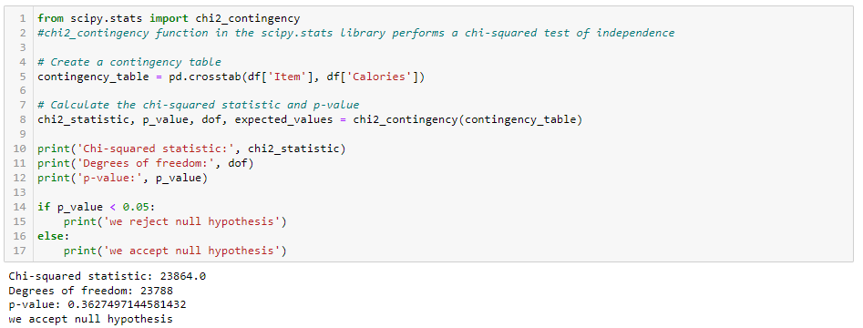
Chi-Square Test:
The test is applied when you have two categorical variables from a single population. It is used to determine whether there is a significant association between the two variables.

Slide 17
Conclusion:
McDonald's nutrition dataset provides valuable information about the nutritional content of McDonald's food. The data shows that there is a wide range of nutritional content across the McDonald's menu, with some items being relatively healthy and others being very unhealthy. The data also shows that sodium intake is a concern for many people who eat at McDonald’s.
Based on my findings, I recommend that McDonald's take steps to educate consumers about the nutritional content of its food, offer healthier menu options, and work with suppliers to improve the quality of its food. McDonald's could also conduct further research on the nutritional impact of its food and partner with public health organizations to promote healthy eating and lifestyle habits.

Slide 18
THANK YOU

